Slide 1
Week 1
10-06-2022
Parth Deshpande

Slide 2
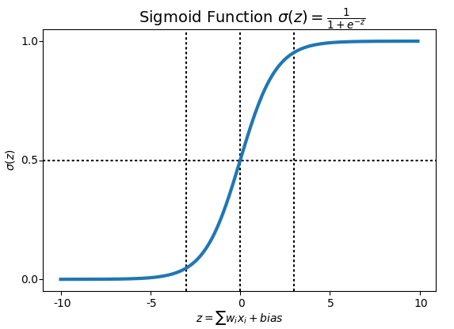
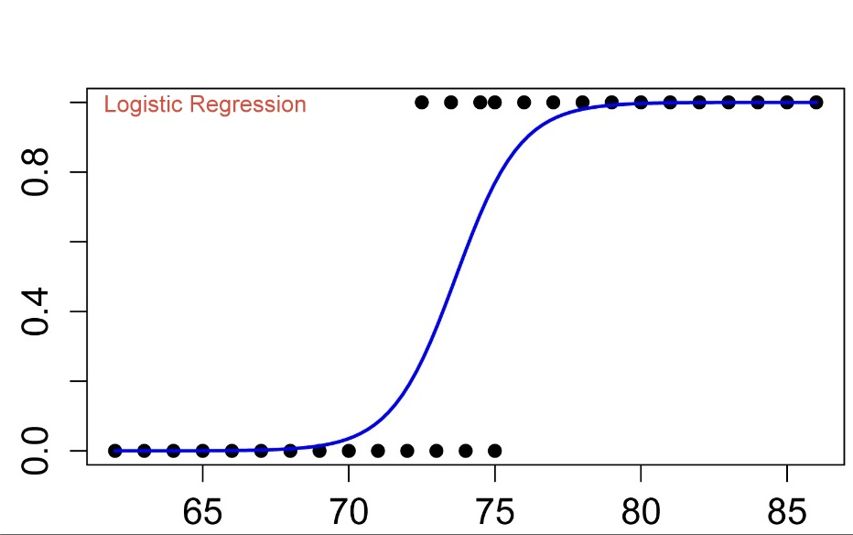
Logistic Regression with a Neural Network mindset
Logistic regression is a method to predict a binary outcome, such as yes or no, based on prior observations of a data set.
In order to map predicted values to probabilities, we use the Sigmoid function. The function maps any real value into another value between 0 and 1.

Slide 3
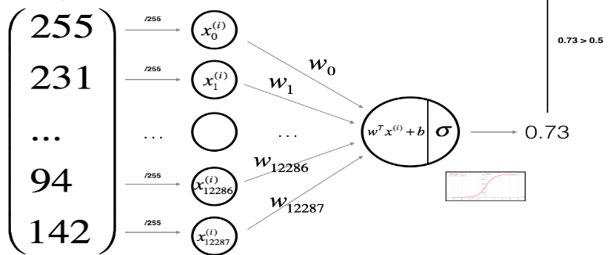
we can think of logistic regression as a one layer neural network. In fact, it is very common to use logistic sigmoid functions as activation functions in the hidden layer of a neural network

Slide 4

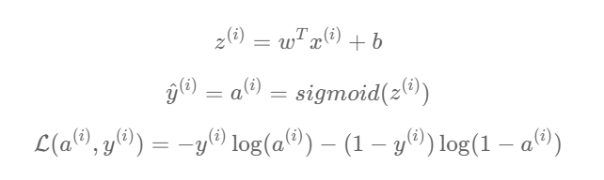

Mathematical expression of the algorithm

Slide 5

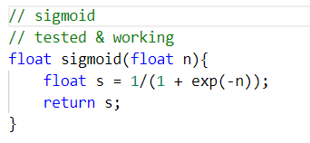
Part-1 Sigmoid

Slide 6
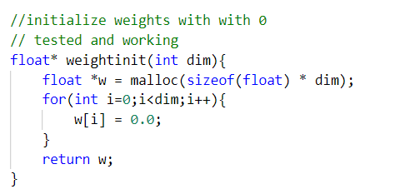
Part-2 Weight initialize with zeros
This function creates a vector of zeros of shape (dim, 1) for w.
Malloc is used to allocate the memory and then return that pointer . If normal float array is used , then the memory allocated to that local array is deallocated when function call ends.

Slide 7
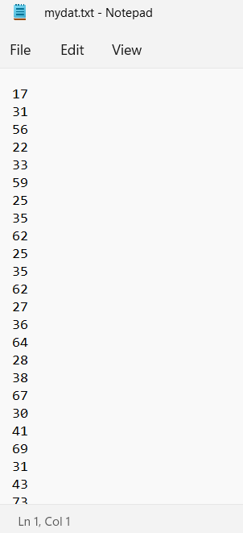
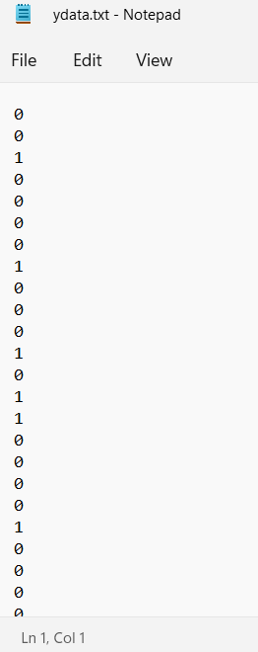
Training Data – input features and y - labels
static float x_train[12288][50];
static float y_train[50];
static int NoOfEx = 50;
As the available training dataset was in .h5 format ,
I converted it into C-readable format in a .txt file with pixel values in each newline
Group of 12288 pixels(every 12288 lines in text file)
represent (64 x 64 x 3) image and corresponding 0/1 label

Slide 8
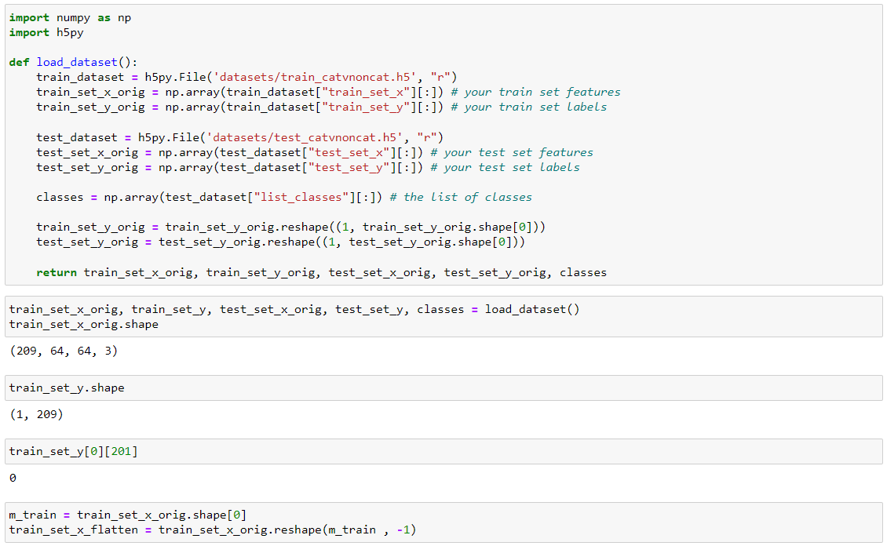

Slide 9
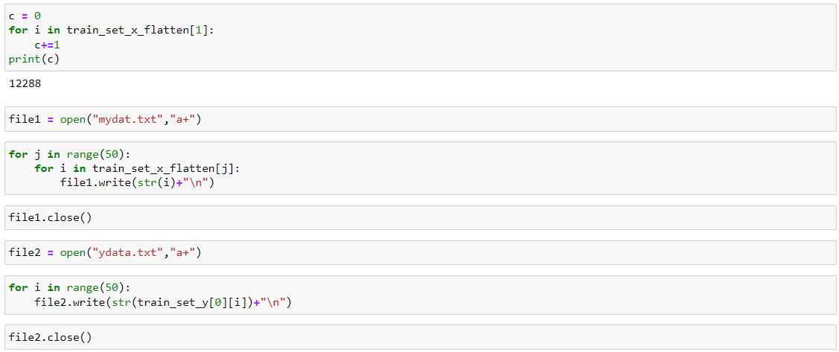

Slide 10
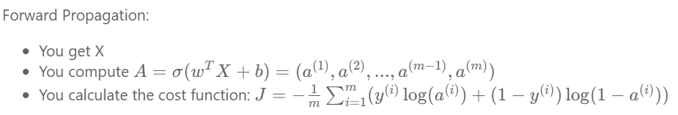
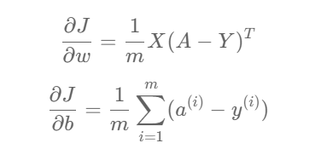
Part-3 Forward and Backward propagation
For backward propagation partial derivatives,
w -- weights, an array of size (num_px * num_px * 3, 1)
b -- bias, a scalar
X -- data of size (num_px * num_px * 3, number of examples)
Y -- true "label" vector (containing 0 if non-cat, 1 if cat) of size (1, number of examples)

Slide 11
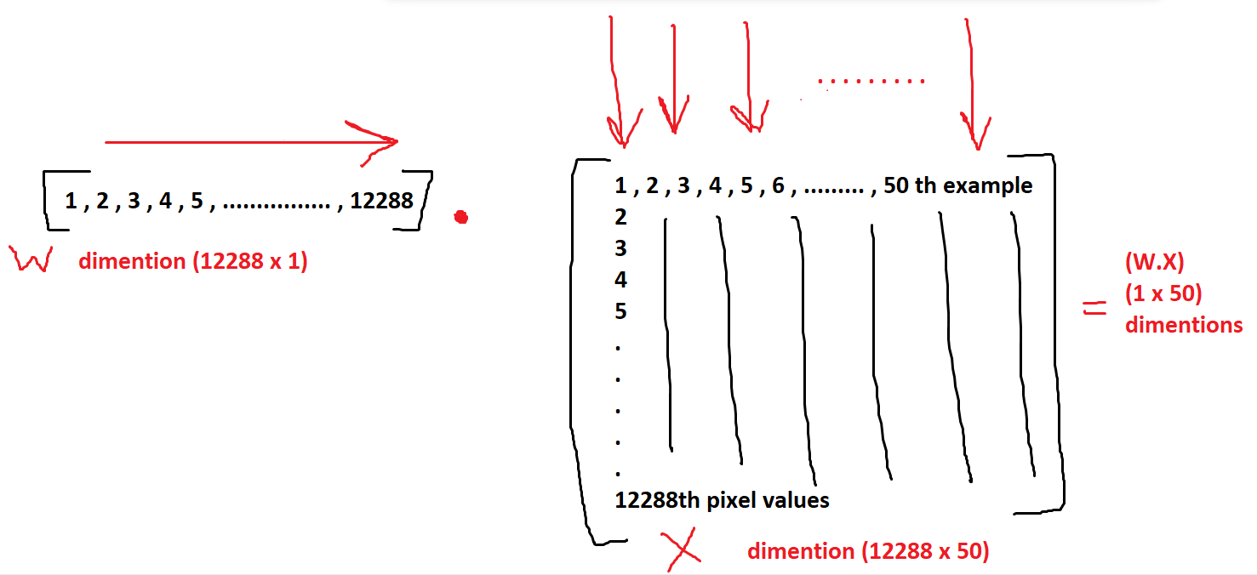

Slide 12
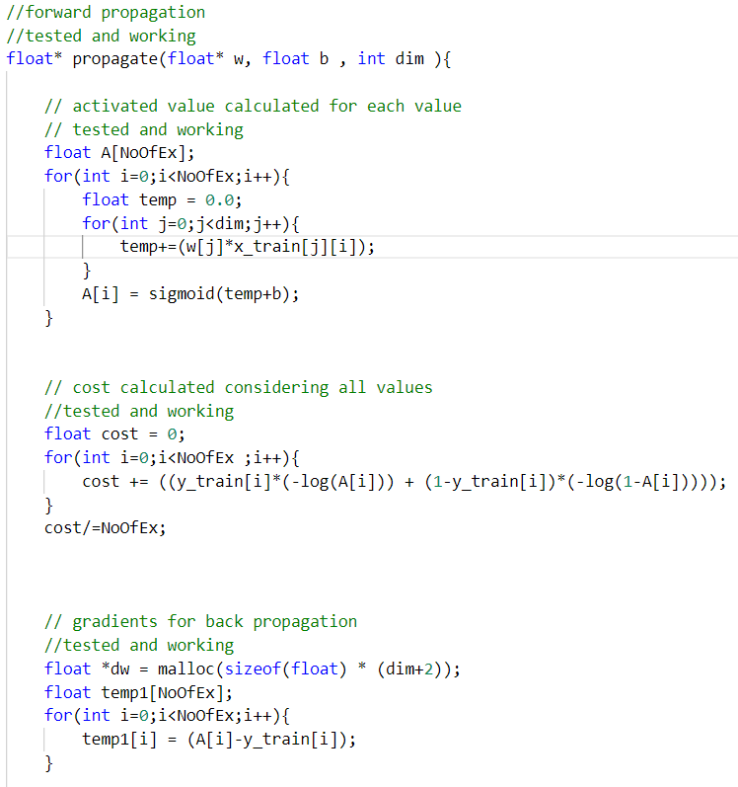

Slide 13
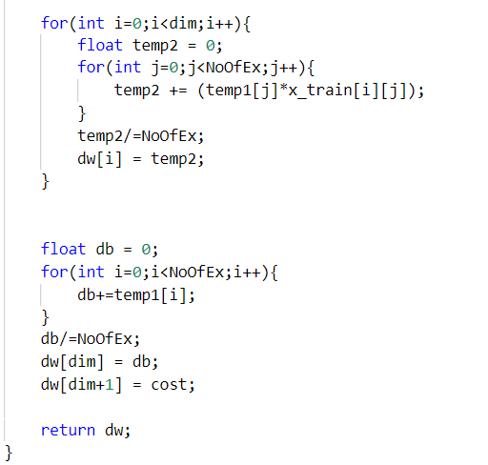
Return:
cost -- negative log-likelihood cost for logistic regression
dw -- gradient of the loss with respect to w, thus same shape as w
db -- gradient of the loss with respect to b, thus same shape as b

Slide 14
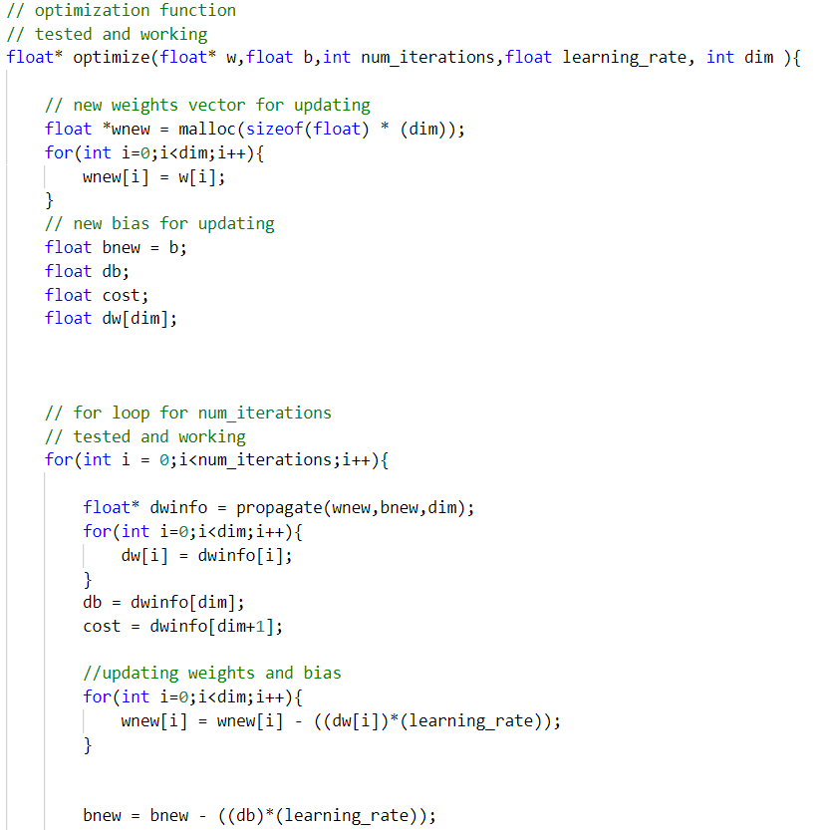
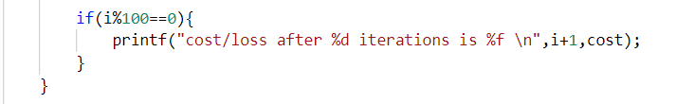
Part-4 Optimization

Slide 15
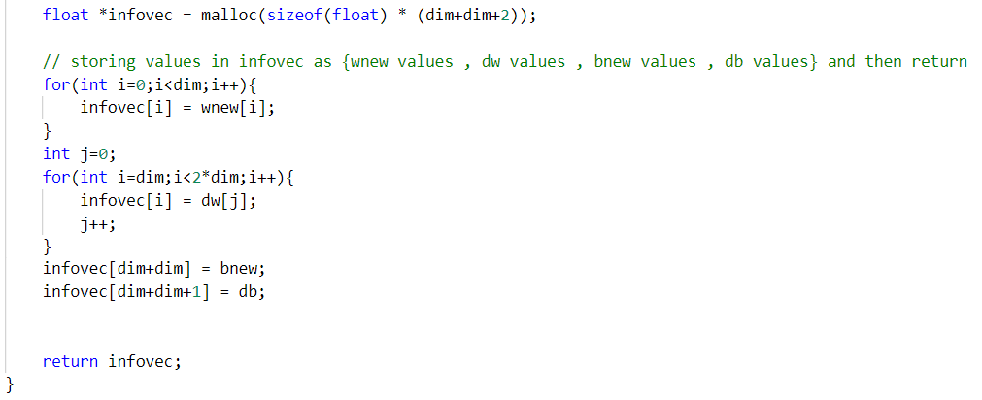

Slide 16
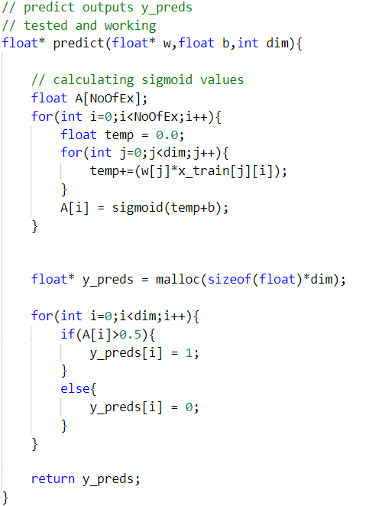
Part-5 Predict

Slide 17
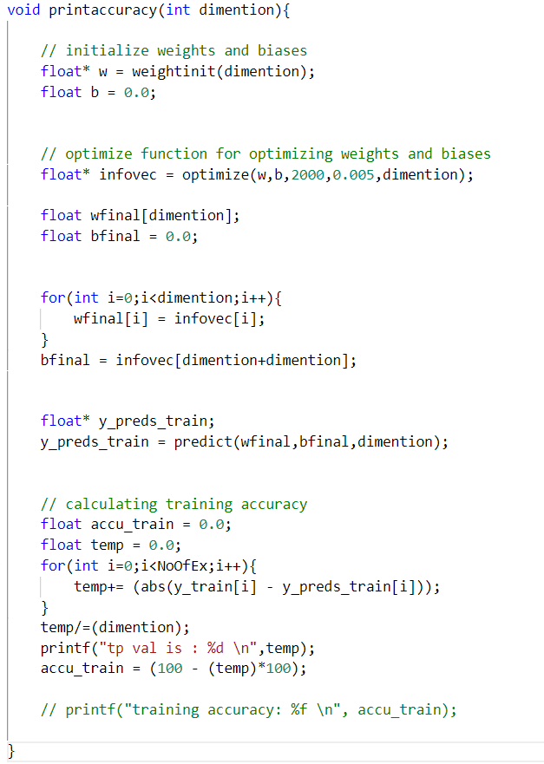
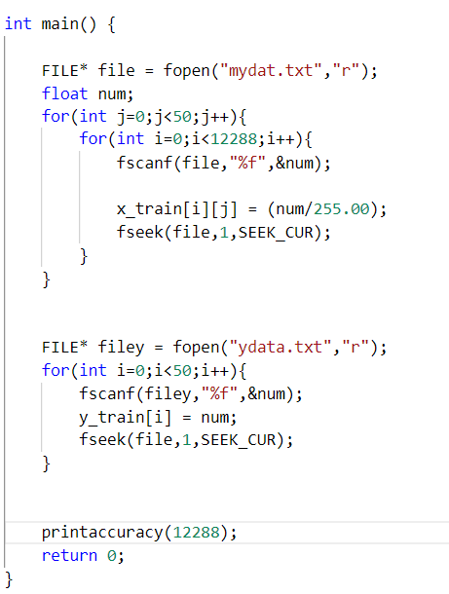

Slide 18
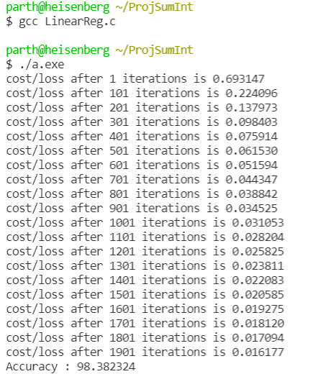
Conclusion :
Overfitting !!

